Slide 1
My Greatest Success
By Anthony McKale

Slide 2
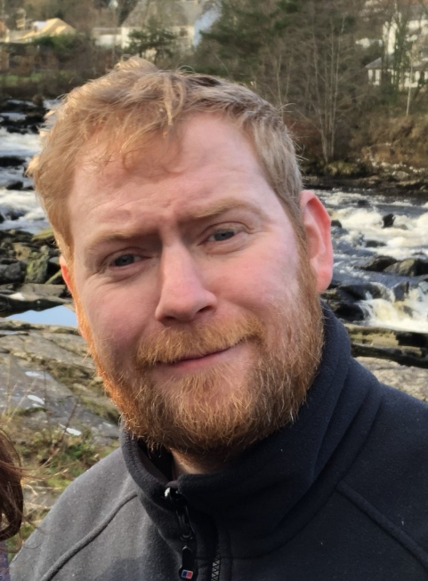
My Greatest Success
I’ve chosen 2 important projects from early in my career They: shaped me; forged me; made me who I am Topic : “My Greatest Success”

Slide 3
agenda
MY CAREER
FIRST EPIC PROJECT
LESSIONS
SECOND EPIC PROJECT
OUTRO

Slide 4

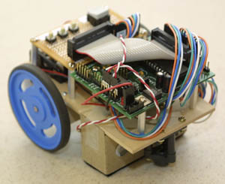
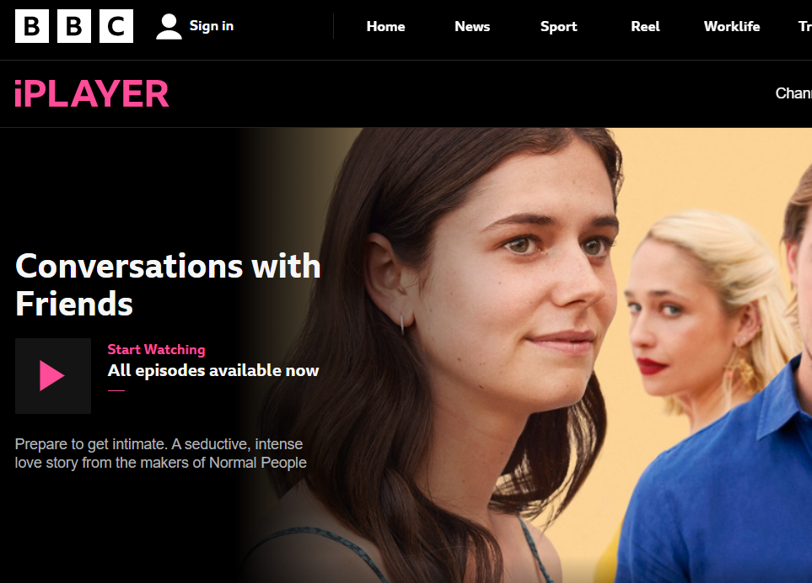
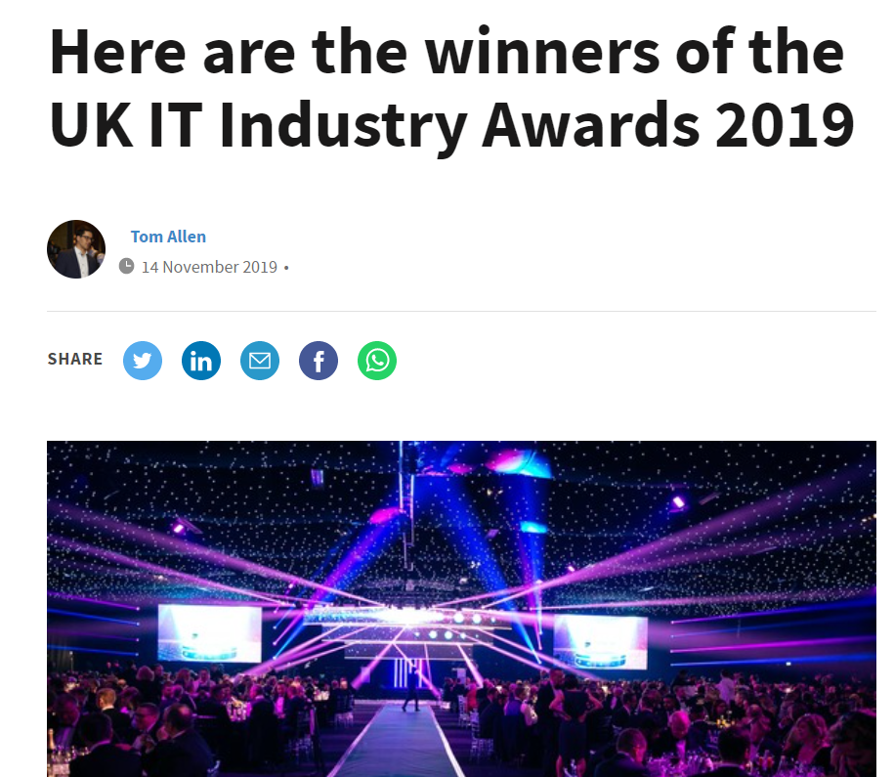
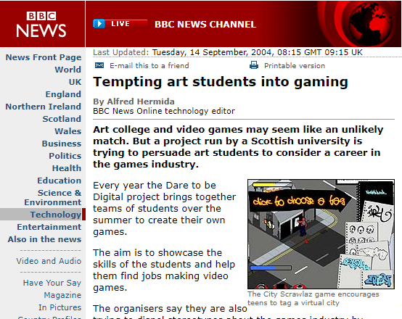
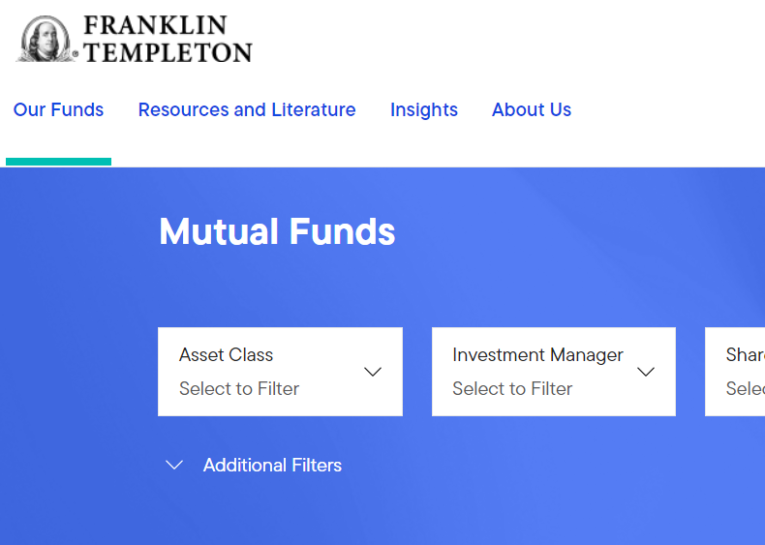

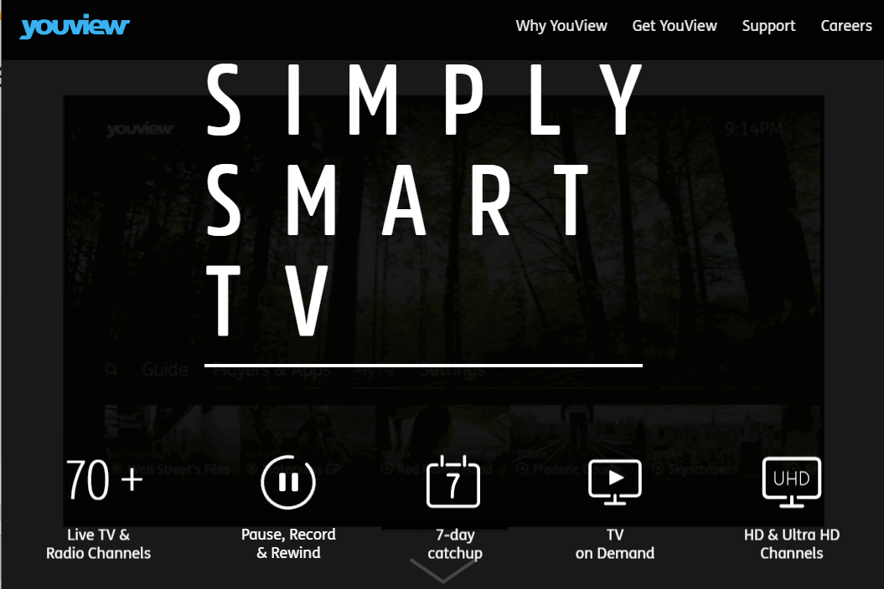
My Career

Slide 5
My Career
1) University
2) BBC
3) Glorious Contracting Days
4) Life Changing Moment 5) Permie Street

Slide 6
University (2000-2004)
DUAL DEGREE
Artificial Intelligence / Software Engineer 2:1 (69%)
INTERESTS (2000)
Edinburgh University Orchestra, Compsoc, Gamesoc, Edgar
INTERESTS (2004)
Gamesoc, Edgar (Edinburgh Rock and Goth Society)

Slide 7
University (2000-2004)
NOTABLE PROJECTS
Simulated a cricket lower-brain to drive a robot
Won a robot sumo competition
Once got 150% by partially solving a deliberately impossible practical exercise
After Uni won “Dare to be Digital” Gaming Competition

Slide 8
BBC (2004-2011)
NOTABLE PROJECTS
BBC CBBC BBC Jam iPlayer (Bafta winning), and more….

Slide 9
BBC (2004-2011)
NOTABLE PROJECTS
Continued…
Dozens of local Scottish Websites
Dozens of flash games (one of won a Bafta)
Bitesize
BBC Jam
Forge (BBC core platform)
iPlayer (Bafta winning)
BBC Radio and Music Websites
BBC News Website
BBC CBBC Website
BBC Cbeebies Website
and more….

Slide 10
BBC (2004-2011)
I was so busy and popular I was even spoken of in plural form

Slide 11
Mark Thomson BBC Director-general (2007) all hands BBC PQ Glasgow
“I would like to thank the Brilliant flash resources from Scotland.
For making iPlayer possible.”

Slide 12
Contracting (2011-2021)
NOTABLE PROJECTS
2021: RiverSafe’s Eze (Principal Engineer) open-source security orchestrator 2020: Natwest’s Ask Archie AI (Principal Engineer) nice little AI Chatbot, won a BCS award 2016: Sky’s OTT, Contact Centre and PCI Dashboards (Tech Lead) So popular it created Sky’s Dashboard and Monitoring Team 2012: Youview Core UI / iPlayer Youview (Senior Engineer) Learn how to code with 16mb of RAM

Slide 13
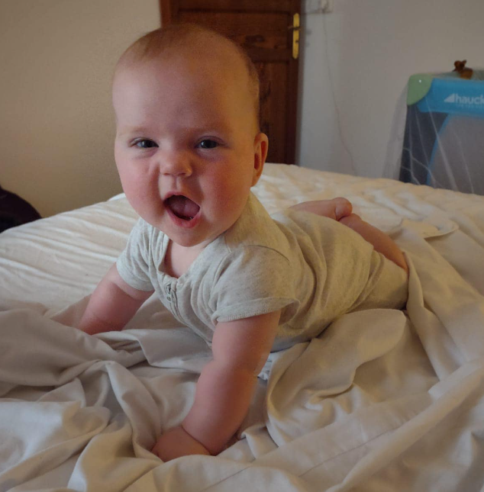
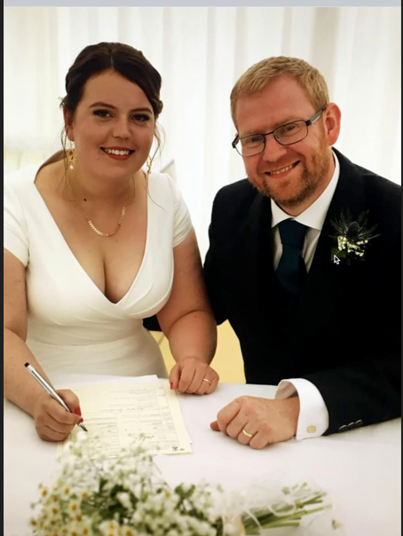
Life Changing Moments (2021)
9 Months later

Slide 14
PAYE RiverSafe (2022)
NOTABLE PROJECTS
2022: Sky’s Heimdall (Principal Engineer) Proprietary security orchestrator + dashboard + pipeline integration Handling about 16k of production repos Full SCA / SAST / Secrets / License scanning
2022: RiverSafe’s Eze (Principal Engineer) open-source security orchestrator
2022: RiverSafe’s Academy (Principal Engineer) Inhouse intensive bootcamp for turning graduates into devops engineers

Slide 15
Career
Far to say I’ve seen a thing for two

Slide 16
agenda
MY CAREER
FIRST EPIC PROJECT
LESSIONS
SECOND EPIC PROJECT
OUTRO

Slide 17

First Epic Project

Slide 18
First Epic Project
a.k.a
my worst project

Slide 19
My “BBC Jam” (2006)
1) Hopeful Start
2) Roaring Middle
3) Thudding End

Slide 20
My “BBC Jam” : Hopeful Start
After 2 year illustrious BBC career I’m personally picked for BBC Scotland’s Biggest ever project
I got my big break, to work on real software

Slide 21
My “BBC Jam” : Hopeful Start
JAM was bigger and better than any project I’d done :
£150 million budget
Hundreds of engineers, qa, managers, Education consultants across 10 sub-teams
Built using the latest waterfall methodologies
Afford to pay me a full £22k/year previously on £16k/year rolling 3 month contract

Slide 22
My “BBC Jam” : Roaring Middle
In Scotland we’d been given 3 of 12 modules We were 6 months behind schedule, when I started But I’d came from gaming and knew the solution…

Slide 23
My “BBC Jam” : Roaring Middle
The solution:
Mad Ninja Coding Skills
Crunch time
Hence went full Ninja Crunch time (16 hour days as standard)

Slide 24
My “BBC Jam” : Roaring Middle
We had great success, and module after module was completed Manager heaped praise at my often single-handed efforts
Fellow developers, were less praising…

Slide 25
My “BBC Jam” : Thudding End
Unfortunately the work piled up:
Months of long hours and deadlines, started to tire all
Deadline set years before, demanded jury-rigged coding, with steadily increasing technical debt
Layers of Management, created hundreds of pages of in-depth labyrinthian documentation (ironically often out-of-date, or simply incorrect)
…

Slide 26
My “BBC Jam” : Thudding End
Unfortunately the work piled up:
…
50% of the work had been handed out to 3rd non-BBC parties

Slide 27
My “BBC Jam” : Thudding End
Of the 50% 3rd non-BBC completed work:
Approximately 100% had to be re-done by internal staff

Slide 28
My “BBC Jam” : Thudding End
Internal Staff already woefully understaffed as burned out developers started to resign or leave
Unfortunately, it was the good or clever ones that left first

Slide 29
My “BBC Jam” : Thudding End
After about a year of 16 hour days, and crushing work load
Tired and angry at my failure as a developer, for not doing better…
I too moved on, going back to my old job in BBC Scotland Interactive

Slide 30
My “BBC Jam” : Thudding End
A few months later, the EU commission legally challenged the project on competition grounds
The project was shutdown

Slide 31
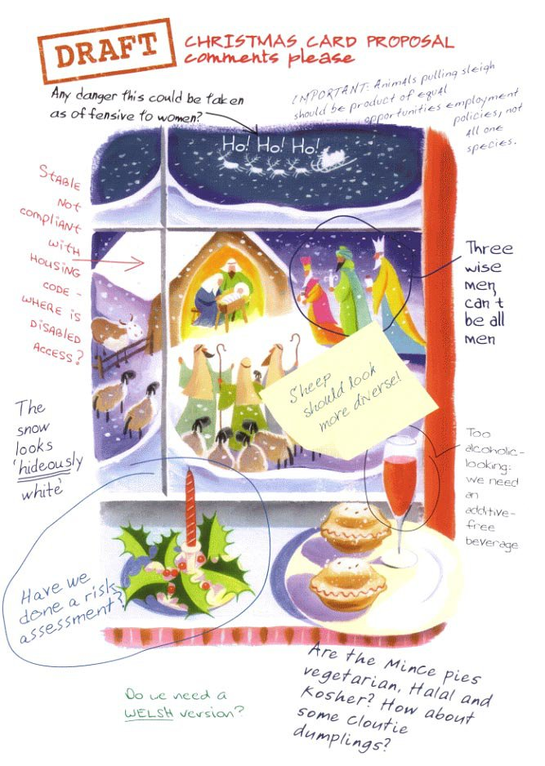
Real BBC Office Christmas Card (2006)

Slide 32
agenda
MY CAREER
FIRST EPIC PROJECT
LESSIONS
SECOND EPIC PROJECT
OUTRO

Slide 33
First Epic Failure Lessons Learnt

Slide 34
Lessons Learnt
BBC Jam was/is my biggest failure
My hardest project
After a few months I reflected
Never again

Slide 35
Lessons Learnt
Lessons I learnt :
Politics
Ninja Coding
Team work
Waterfall
Fate

Slide 36
Lessons Learnt
Politics: To win wars, pick your battles
also learn when to shut up, or when the battle is lost not to be bitter

Slide 37
Lessons Learnt
Ninja Coding: It’s bad for your health, and it’s also terrible for Tech debt there’s nothing more permanent than a proof of concept prototype rushed into production

Slide 38
Lessons Learnt
Team work: A problem shared is a problem cut in 1.5* individuals don’t scale to workload, not matter how talented you got to work with your team, can’t hero program * Mythical Man-Month Joke: Ask me afterwards

Slide 39
Lessons Learnt
Waterfall: Ironically terrible at delivering stuff on time
never estimate in time but story points
working code more important than documentation

Slide 40
Lessons Learnt
Fate: Not every problem is technical
also you can’t save every project

Slide 41
Lessons Learnt
Those Lessons helped my Greatest Success

Slide 42
agenda
MY CAREER
FIRST EPIC PROJECT
LESSIONS
SECOND EPIC PROJECT
OUTRO

Slide 43

Second Epic Project

Slide 44
Second Epic Project a.k.a my best project

Slide 45
My “iPlayer” (2007)
1) Dreadful Start
2) Roaring Middle
3) Satisfying End

Slide 46
My “BBC iPlayer” : Dreadful Start
iPlayer v1 was a beast
After years of development a desktop Peer-to-peer app was released
The critical reception was poor
BBC needed a web based streaming version

Slide 47
My “BBC iPlayer” : Dreadful Start
I ran the BBC’s Internal Flash Working group
We rallied myself and 2 senior developers to convince the BBC high ups Flash was superior to Silverlight
The completed product deadline of 10 weeks was set, to hit all important Christmas ratings

Slide 48
My “BBC iPlayer” : Roaring Middle
Luckily, due to BBC Jam we had Flash video experience
We had reusable code and unused servers Management had licensing and security audits for all assets fresh from BBC JAM

Slide 49
My “BBC iPlayer” : Roaring Middle
10 developers team, 10 weeks Converting the core of my Scottish Media Player (Glasgow), into the Embedded Media Player (London)
We used agile incremental development, CI servers, even did a little Unit testing

Slide 50
My “BBC iPlayer” : Roaring Middle
Every week we got closer, as our dev environment matured
We knew when to:
accept weird requirements volume to 11…
push back on poor requirements tivo’s back 10 seconds, due to 20 second seek latency

Slide 51
My “BBC iPlayer” : Roaring Middle
We 10 worked hard
together against the world as a team
Towards that Christmas goal

Slide 52
My “BBC iPlayer” : Satisfying End
Rest is history : We hit Christmas by the skin of our teeth (ask me about pre-warming metadata servers) A standing team of 20 contractors was grown to maintain our media player code I even got a promotion to Senior Developer Youngest in the BBC at only 24

Slide 53
My “BBC iPlayer” : Satisfying End
Lessons applied :
Politics
Ninja Coding
Team work
Waterfall
Fate

Slide 54
agenda
MY CAREER
FIRST EPIC PROJECT
LESSIONS
SECOND EPIC PROJECT
OUTRO

Slide 55
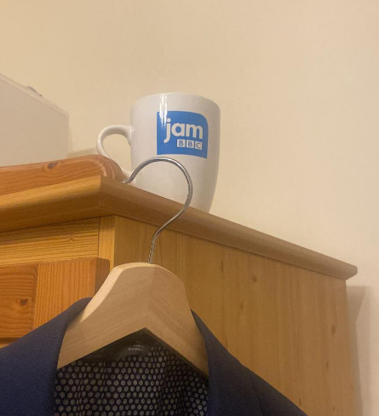
summary
I’ve been Anthony “Zapper” M^{c}Kale
Hopefully I’ve Educated, Informed, and even Entertained Ask me about the Mug after the presentation

Slide 56
thank you
Anthony McKale
anthony@zapper.hodger.com

